Slide 1
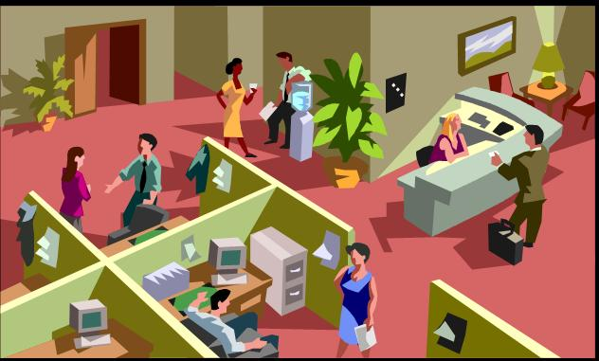
Work Etiquette
&
Professional Communication

Slide 2
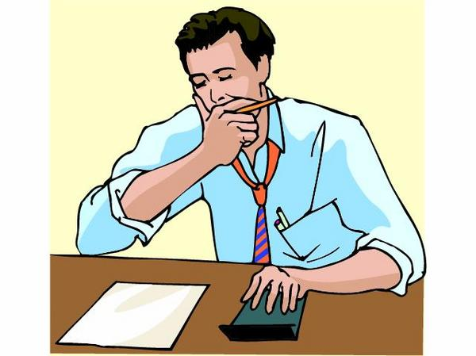
Typical Questions
What should I do in that situation?
What is the right behavior/attitude?
Company
I
My Colleagues

Slide 3
Objectives
Understand some Principles of Work Etiquettes
➔ Prepare for your working life
➔ Overcome challenges at workplace & to be succeeded in your career

Slide 4
Objectives
Professional Behavior

Slide 5
I. Work Etiquette

Slide 6

Be on-time!

Slide 7

Keep our commitments

Slide 8

Respect Others

Slide 9
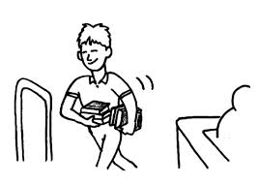
Ask before borrowing

Slide 10
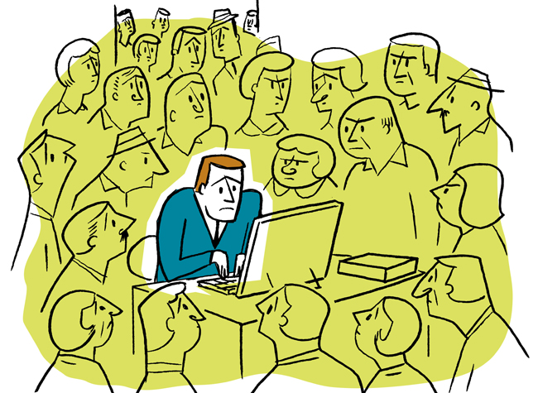
Privacy

Slide 11

Teamwork
Share - Help – Collaborate

Slide 12
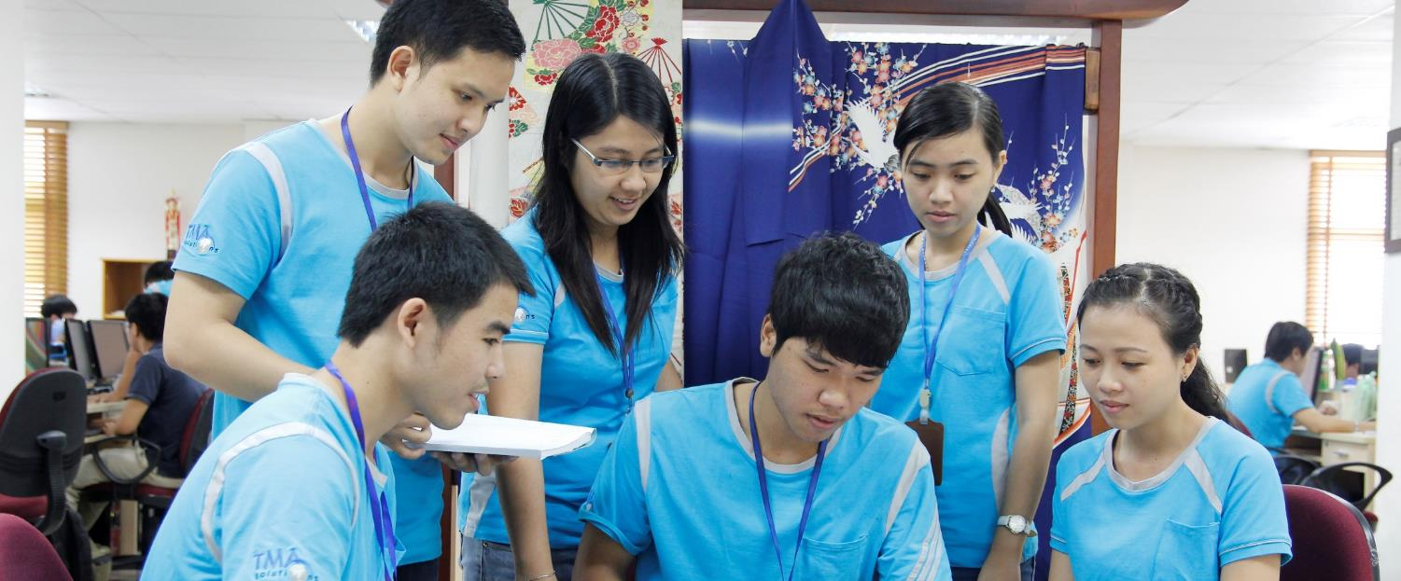

Separate Work & Personal

Slide 13

Everything Clear!
Clarify - Confirm – Inform

Slide 14

Using English at work
It is important as we do services for foreigner

Slide 15

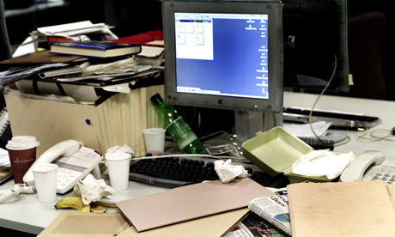

Keep workplace clean & tidy

Slide 16

Using Email

Slide 17


Using Phone

Slide 18
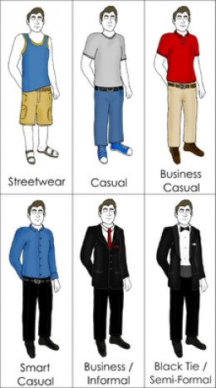
Dressing Appropriately

Slide 19

Build Trust
Keeping your Promises
Keeping your Standard Always High Quality

Slide 20
II. Professional
Communication

Slide 21
Let discuss some cases…
What should I do if
I cannot come on-time?

Slide 22
Let discuss some cases…
What should I do if
I don’t understand the assignments?

Slide 23
Let discuss some cases…
What should I do if
I cannot finish the assignment?

Slide 24
Let discuss some cases…
What should I do
in a training course,
in a meeting?

Slide 25
Let discuss some cases…
What should I do if
I want to increase my salary?

Slide 26
Let discuss some cases…
What should I do if
I hate someone in the team?

Slide 27
Let discuss some cases…
What should I do if
I don’t like my boss?

Slide 28
Let discuss some cases…
What should I do if
I don’t agree with a new policy?

Slide 29
Let discuss some cases…
What should I do if
I want to take a day off suddenly?

Slide 30
Let discuss some cases…
What should I do if
I want to quit the job?

Slide 31
Let share your cases…

Slide 32

Some Principles
Short term vs. long term view
Clear communication
Attitude
  Cooperative with your colleagues
  Benefits to your company
  Develop your career

Slide 33

Good luck to your professonal career!

